Slide 1
Analytical instrumentation Section-2, Ppt-24

Slide 2
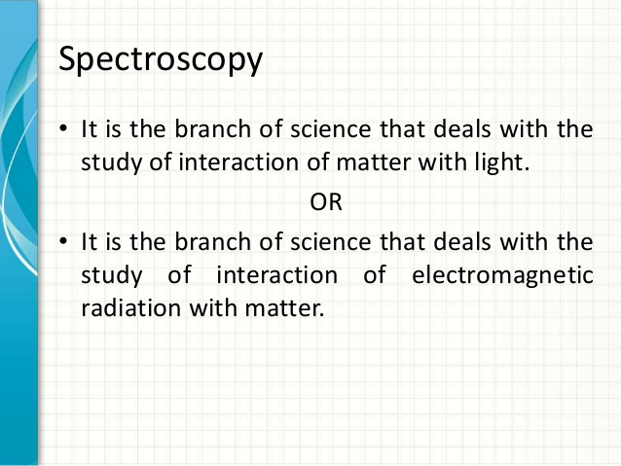

Slide 3
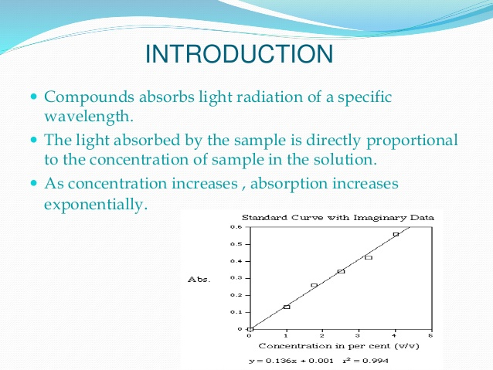

Slide 4
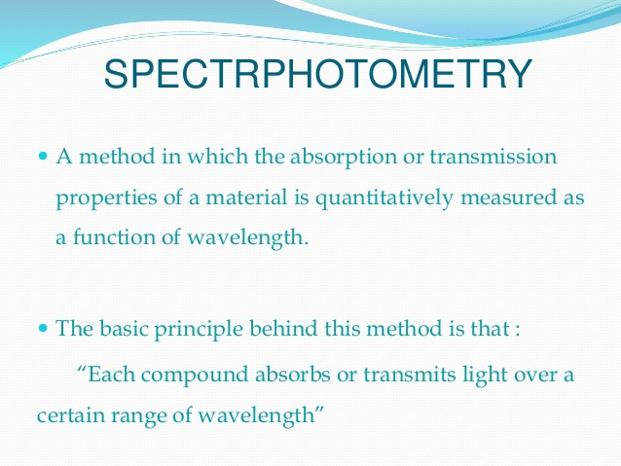

Slide 5
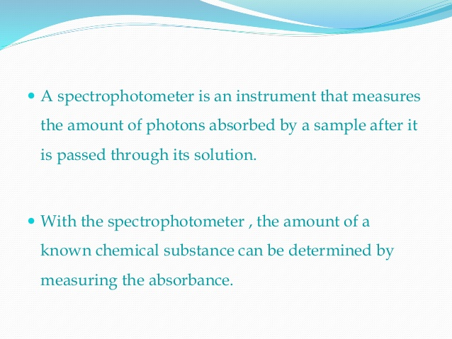

Slide 6
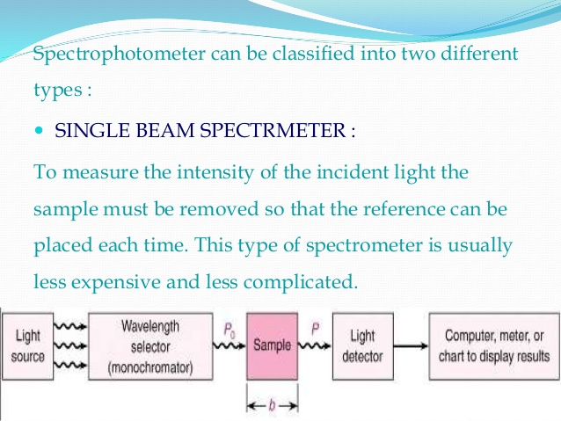

Slide 7
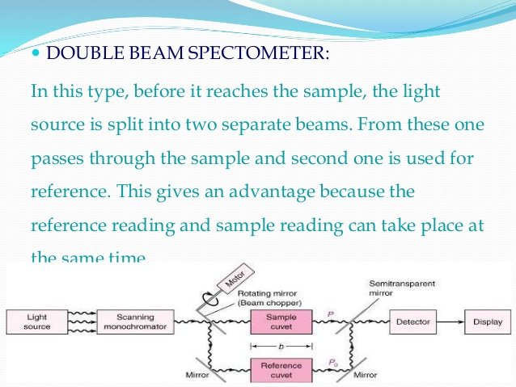

Slide 8
Chromatography
Chromatography’ is an analytical technique commonly used for separating a mixture of chemical substances into its individual components, so that the individual components can be thoroughly analyzed.

Slide 9
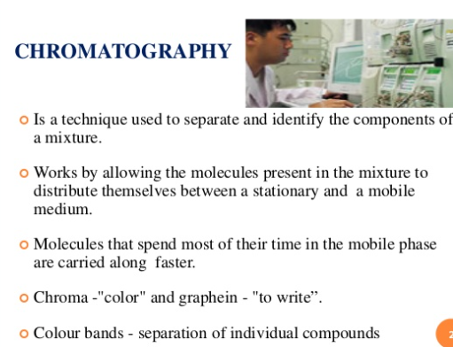

Slide 10
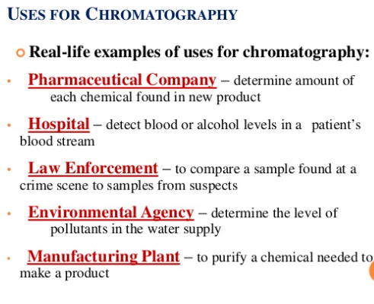

Slide 11
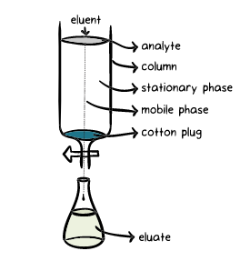
Mobile phase or carrier | solvent moving through the column
Stationary phase or adsorbent | substance that stays fixed inside the column
Eluent | fluid entering the column
Eluate | fluid exiting the column (that is collected in flasks)
Elution | the process of washing out a compound through a column using a suitable solvent
Analyte | mixture whose individual components have to be separated and analyzed

Slide 12
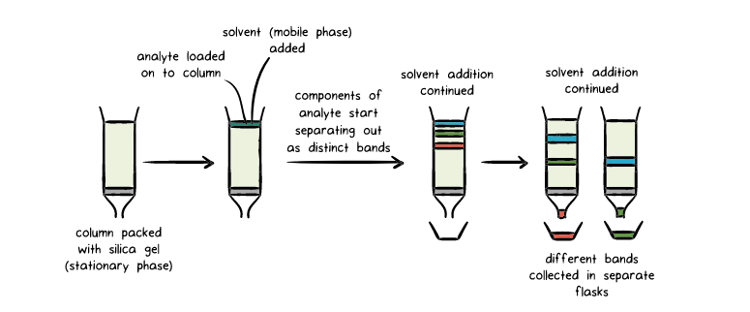

Slide 13
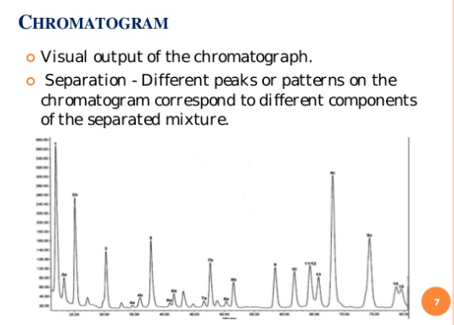

Slide 14
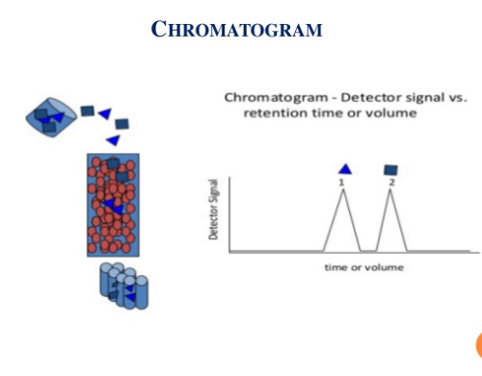

Slide 15
Here, silica acts as the stationary phase.
Solvent (mobile phase) is then made to flow through the silica bed (under gravity or pressure).
The different components of the analyte exhibit varying degrees of adhesion to the silica (see later), and as a result they travel at different speeds through the stationary phase as the solvent flows through it, indicated by the separation of the different bands.
The components that adhere more strongly to the stationary phase travel more slowly compared to those with a weaker adhesion.

Slide 16
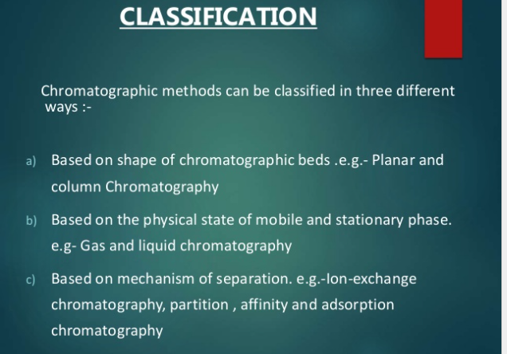

Slide 17
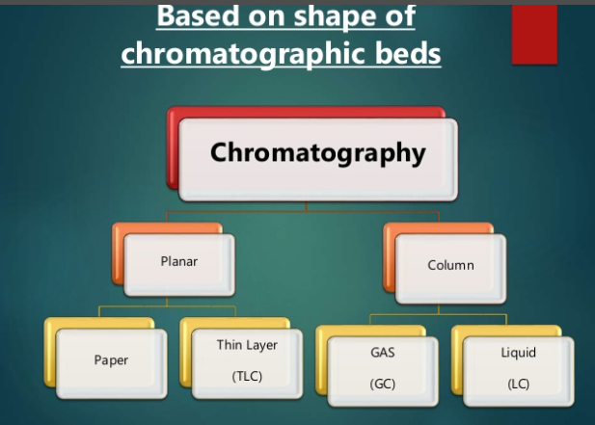

Slide 18
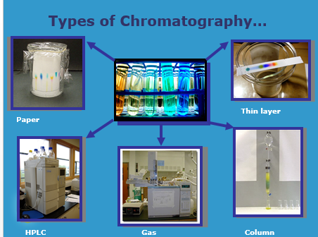

Slide 19
Thank you

